Slide 1
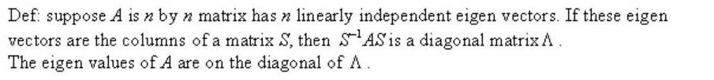
Exercise 5.2 Diagonalization of a matrix

Slide 2
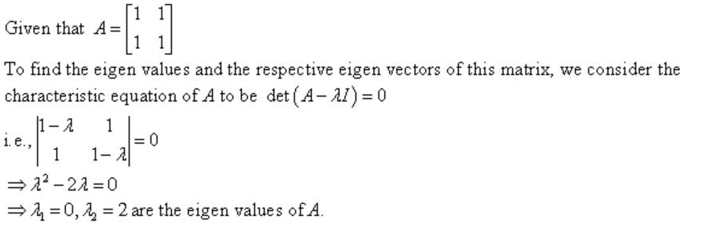
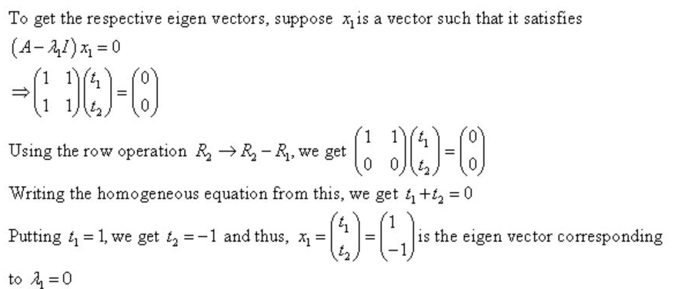
Quest No.1 (solution)

Slide 3
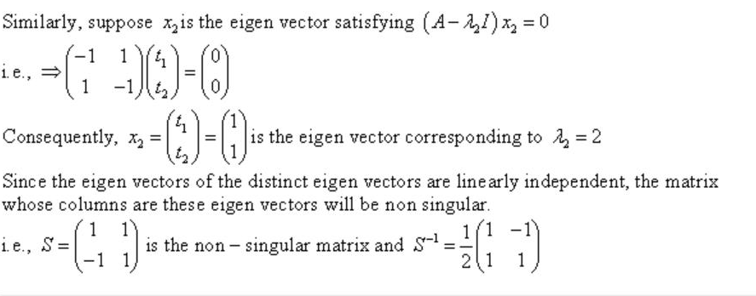
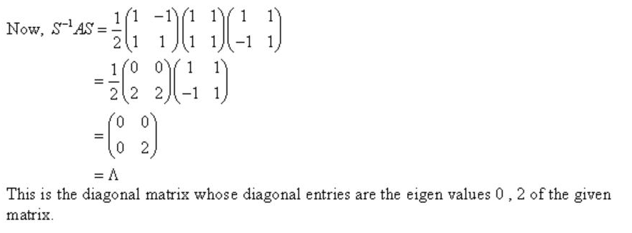

Slide 4
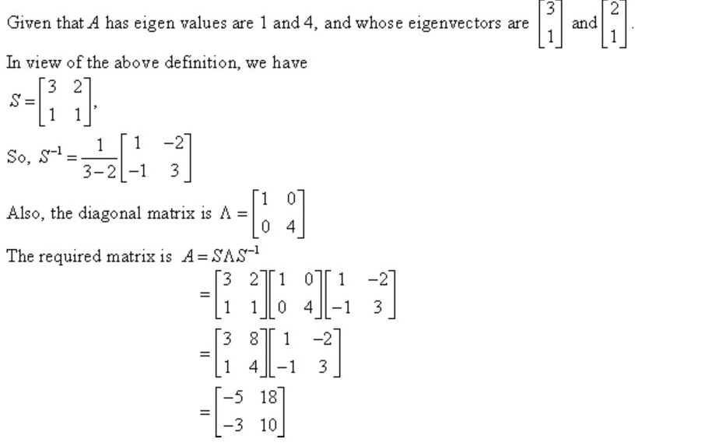
Question 2(Solution)

Slide 5
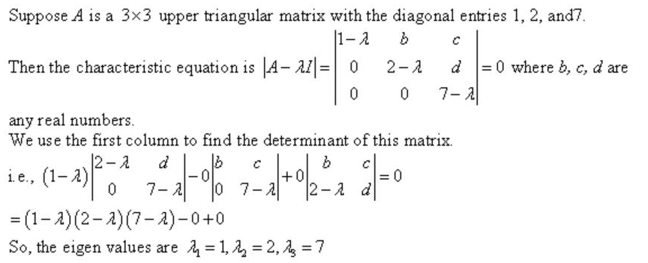
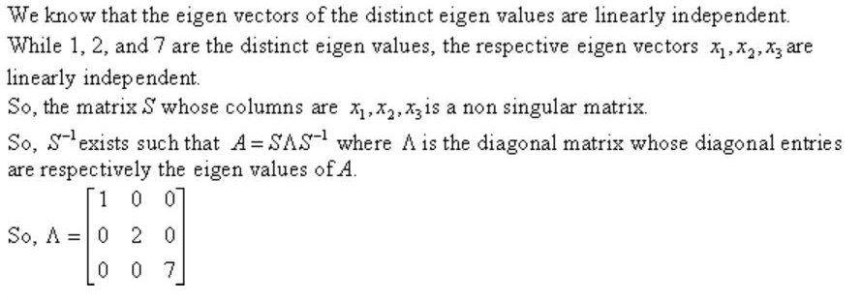
Question 4 (Solution)

Slide 6
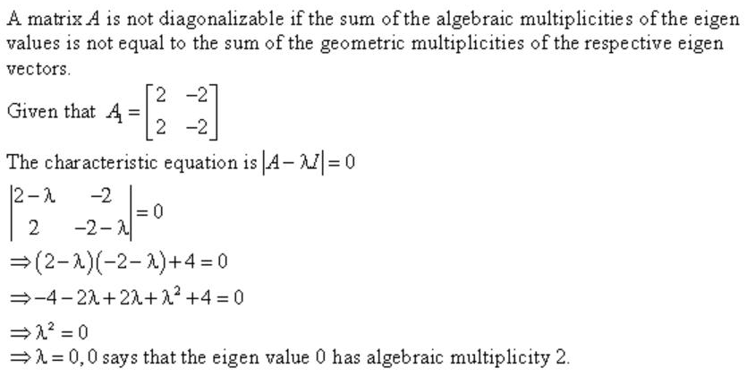
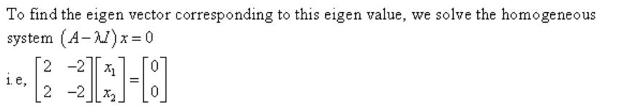
Question 5 (Solution)

Slide 7
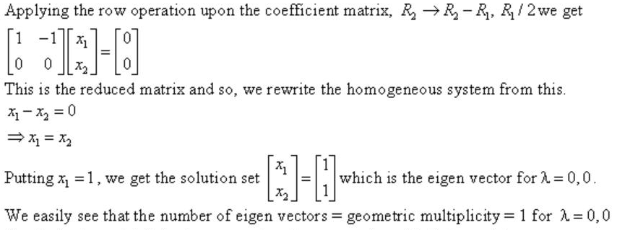
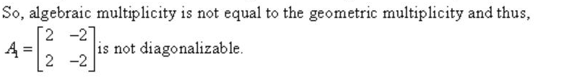

Slide 8
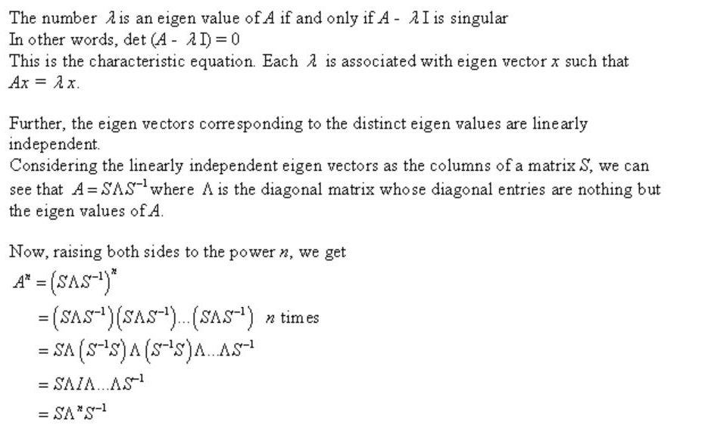
Solution 7 (Solution)

Slide 9
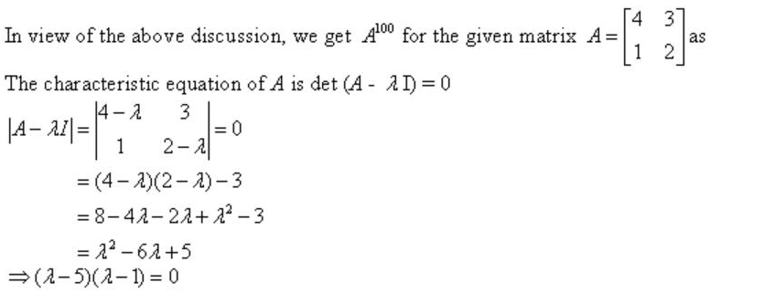

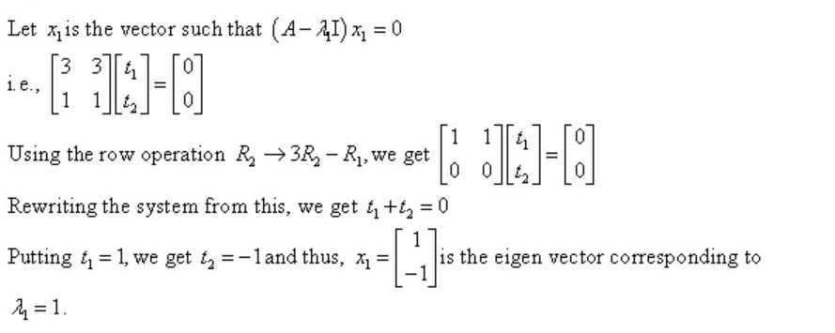

Slide 10
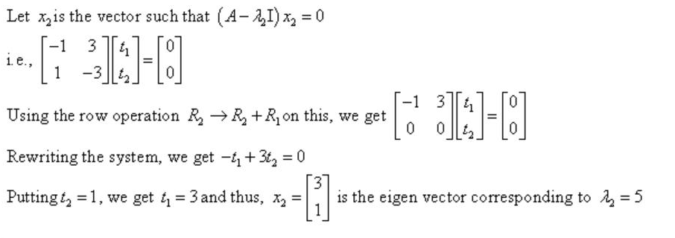
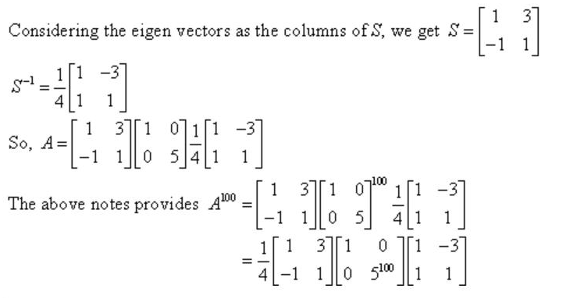

Slide 11
Question 15 to 24 are related to eigen values and eigen vector so solve these problems by yourself. Remember that to calculate eigen value you have to solve det(A-λI)=0 and to get eigen vector, u have to solve (A- λI)x=0. S is formed by putting the first eigen vector in first column and second eigen vector in the second column of a matrix that is S. When we multiply S⁻¹AS, we get diagonal matrix with diagonal entries as the eigen values of A.

Slide 12
Question 29 to 33 are related to the power of a matrix and its procedure is same as we did in problem 7. All other problems are related to eigen values and eigen vector and then their diagonalization or their power. So use the above concept to do all the related problems by yourself.

Slide 13
Diagonalization: A ¹⁰⁰ Algorithm: 1. Eigen values:|(A-λI) |=0 Eigen vector: (A- λI)x=0 S=eigen vector matrix: S⁻¹ and then S⁻¹ AS=diagonal matrix=Ʌ=Diagonal entries that will be the eigen value of the given matrix. A¹⁰⁰=SɅS⁻¹ SɅS⁻¹ SɅS⁻¹ SɅS⁻¹ SɅS⁻¹ ^{(100times)=}SɅ¹⁰⁰S⁻¹ ^{Algebraic multiplicity am} λ=1,2,2,5,7,7,7 Geometric multiplicity gm Defective matrix. If diagonalization is not possible then that matrix is known as defective matrix and we can calculate its jordan form

